Slide 1

Relational Operators and Conditional Statements
if-end
if-else-end
If-elseif … else-end
Nested branching
Switch statements
by
First Year Engineering Learning Center
368 Snell Engineering Building
College of Engineering
Northeastern University

Slide 2
Relational Operators & Logical Operators
< less than > greater than <= less than or equal to >= greater than or equal to = = equal to ~ = not equal to
& and | or ~ not xor exclusive or

Slide 3
Relational Operators
< less than > greater than <= less than or equal to >= greater than or equal to = = equal to ~ = not equal to
compare 2 numbers by determining whether the comparison is TRUE or FALSE.
a < b? If TRUE, operation result is assigned a value of 1
If FALSE, operation result is assigned a value of 0
When 2 arrays are compared, the comparison is done element-by-element and the result is an array of 0’s & 1’s.
% try these examples in the Command Window
>> 5>8 %ans=0 false since 5 is not more than 8
>> 4==4 %ans=1 true since 4 is equal to 4
>> a=[1 3 5], b=[0 4 5], c=a<=b %result?

Slide 4
Order of Precedence – what does MATLAB do 1st?
Arithmetic operations + - * / \ have precedence over relational operators < > <= >= == ~=.
Arithmetic operations * / \ completed before + - .
Relational operations have equal precedence and are completed left to right unless designated by ( ).
% try these examples in the Command Window
>> 3+4<16/2 %ans=1 true since 7<8
>> 3+(4<16)/2 %ans=3.5 since 3+1/2
>> a=[1 3], b=[0 1], c=a.*b>b./a %result?

Slide 5
Logical Operators
& and | or ~ not xor exclusive or
compare 1 or 2 operands.
Any non-zero number is true (1) and a zero is false (0).
TRUTH TABLE OF LOGICAL OPERATORS
A | B | ~A | A&B | A|B | xor(A,B)
0 | 0 | 1 | 0 | 0 | 0
0 | 1 | 1 | 0 | 1 | 1
1 | 0 | 0 | 0 | 1 | 1
1 | 1 | 0 | 1 | 1 | 0

Slide 6
AND (&) Logical Operator
& and | or ~ not xor exclusive or
Example (A<B) & (B<C)
If A<B, the result is TRUE (1)
If B<C, the result is TRUE (1)
1 & 1 if both are true, then 1 & 1 is TRUE (1).
When 2 arrays are compared, the comparison is done element-by-element and the result is an array of 0’s & 1’s.
% try these examples in the Command Window
>> (1<3)&(7>2) %ans=1 true since 1&1 = true(1)
>> (1<3)&(7<2) %ans=0 false since 1&0=false(0)
>> a=[1 3], b=[0 1], (a<b)&(b<2) %ans= 0 0

Slide 7
OR (|) Logical Operator
To type | use shift \
(above enter key on computer keyboard)
& and | or ~ not xor exclusive or
Example (A<B) | (B<C)
If A < B, the result is TRUE (1)
If B not < C, the result is FALSE (0)
1 | 0 if either one is true, then 1 | 0 is TRUE (1).
When 2 arrays are compared, the comparison is done element-by-element and the result is an array of 0’s & 1’s.
% try these examples in the Command Window
>> (1<3)|(7>2) %1|1 ans=1 either one true
>> (1<3)|(7<2) %1|0 ans=1 either one true
>> (1>3)|(7<2) %0|0 ans=0 neither one true

Slide 8
NOT (~) Logical Operator
To type ~ use
shift ` (above Tab
key on keyboard)
& and | or ~ not xor exclusive or
Example ~A
If A = 0, then ~A = 1 (opposite)
If A = 1, then ~A = 0 (opposite)
If A = any non-zero number ⇒ ~A=0
% try these examples in the Command Window
>> B=5; ~B %ans=0 (5 is a non-zero number)
>> C=(1<3) %C=1 since 1<3 true(1)
>> ~C %ans=0

Slide 9
xor Logical Operator
& and | or ~ not xor exclusive or
Example xor(A,B)
If A = 3<4 then A = 1 (true)
If B = 7>2 then B = 1 (true)
If C = 7<2 then C = 0 (false)
xor(A,B) %ans=0 since both are true (not exclusive)
xor (A,C) %ans=1 since A=true and C=false
A or B are true but not both
>> A=3<4 %A=1 (true)
>> B=7>2 %B=1 (true)
>> xor(A,B) %ans=0 (not exclusive)
>> C=7<2 %C=0 (false)
>> xor(A,C) %ans=1 (exclusive)

Slide 10
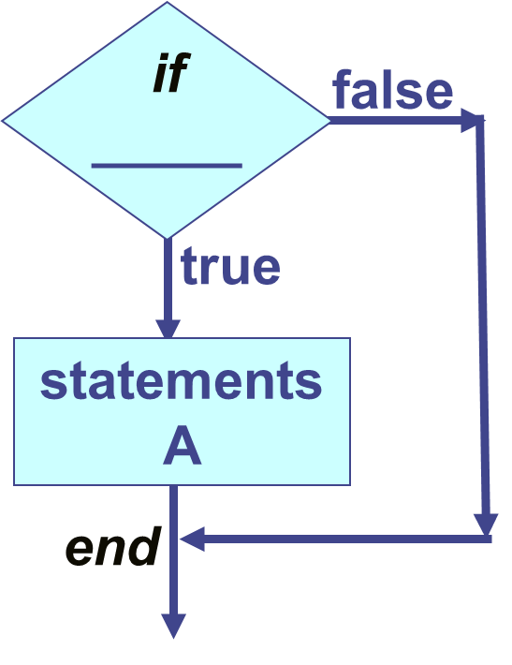
Conditional Statements
Conditional statements can be used in script files or function files but NOT in the Command Window.
Conditional statements allow MATLAB to make decisions within a program based on certain criteria.
Every if statement must be paired with an end statement.
if relational and/or logical expression = true
do this: statements A
end

Slide 11
Conditional Statements if-end
% write in a script .m file
T=[58 70 76 75]
Tabove75=T>=75
days_above75=sum(Tabove75)
if days_above75>0
fprintf('%i days above 75 degrees \n',days_above75)
end
if relational and/or logical expression = true
do this: statements A
end

Slide 12
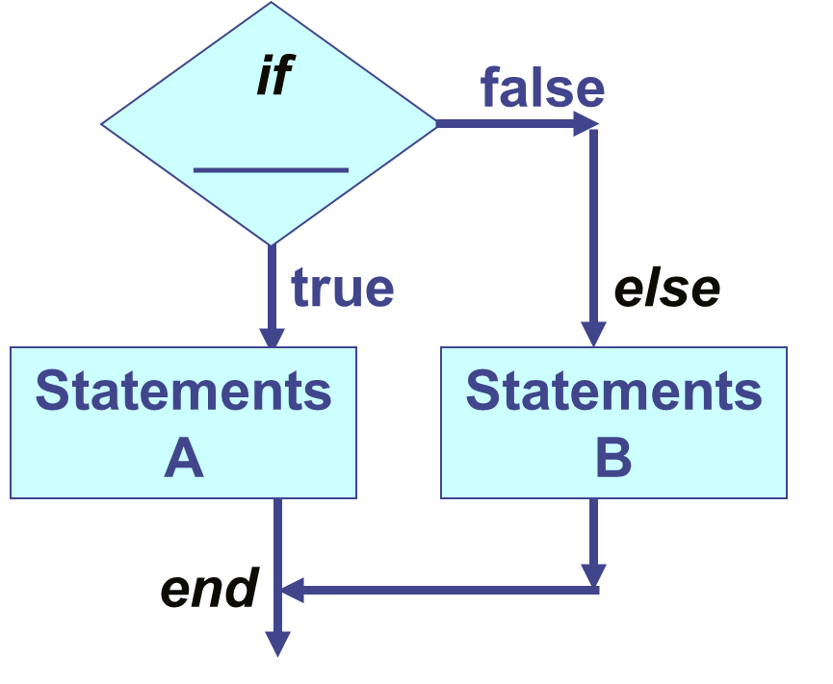
Conditional Statements if-else-end
if expression = true
statements A
else
statements B
end

Slide 13
Example if-else-end
% write in a script .m file
T=[58 70 76 75]
Tabove75=(T>=75)
days_above75=sum(Tabove75)
if days_above75>0
fprintf('%i days above or equal to 75 deg \n',days_above75)
else
fprintf(‘zero days above or equal to 75 degrees \n')
end

Slide 14
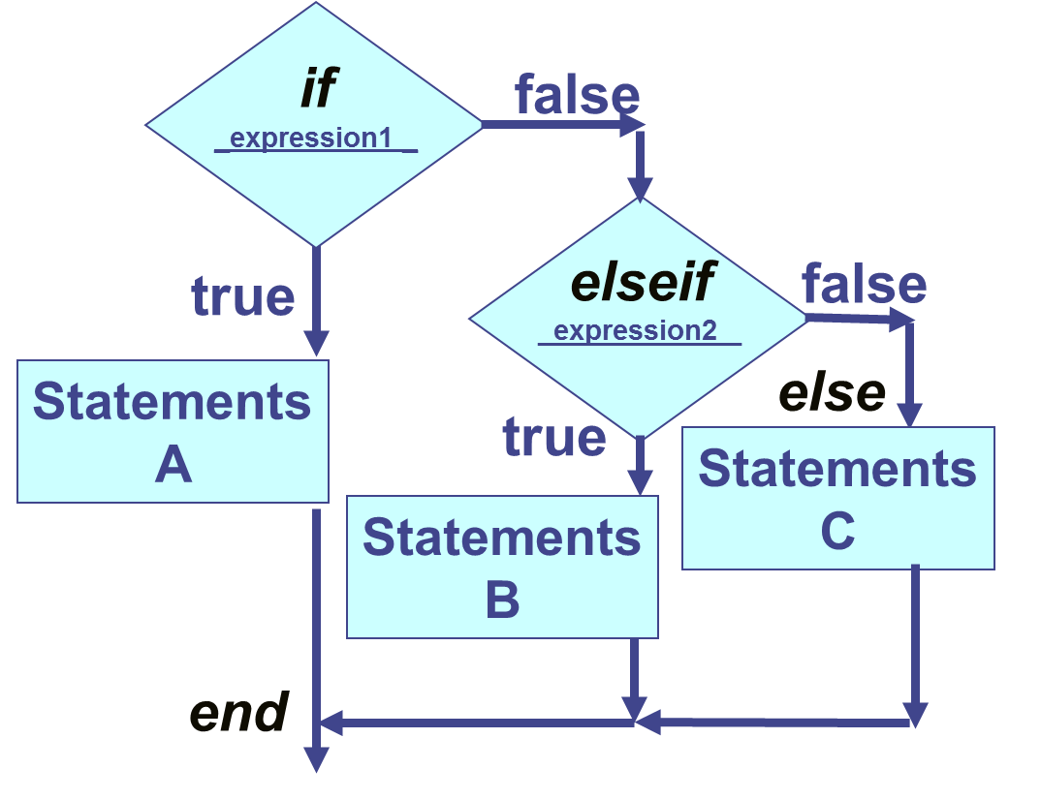
Conditional Statement if-elseif-else-end
if expression1
statements A
elseif expression2
statements B
else
statements C
end

Slide 15
Example: if-elseif-else-end
% write in a script .m file
T=[58 70 76 75]
Tabove75=(T>=75)
days_above75=sum(Tabove75)
if days_above75>1
fprintf('%i days above or equal to 75 deg \n',days_above75)
elseif days_above75==1
fprintf(‘one day above or equal to 75 degrees \n')
else
fprintf(‘zero days above or equal to 75 degrees \n')
end

Slide 16
Nested Branching: multiple else-ifs
if expression1
statements A
elseif expression2
statements B
elseif expression3
statements C
elseif expression4
statements D
else
statements E
end

Slide 17
Nested Branching – multiple elseifs
% write in a script .m file
T=[58 70 76 75]
Tabove75=(T>=75)
days_above75=sum(Tabove75)
if days_above75>3
fprintf(‘all %i days above or equal to 75 degrees! \n',days_above75)
elseif days_above75>1
fprintf(‘%i days above or equal to 75 degrees \n',days_above75)
elseif days_above75==1
fprintf(‘one day above or equal to 75 degrees \n')
else
fprintf(‘zero days above or equal to 75 degrees \n')
end

Slide 18
Nested Branching – many else-ifs
if expression1
statements A
elseif expression2
statements B
elseif expression3
statements C
elseif expression4
statements D
else
statements E
end
Too many elseif branches?!
Too complicated?!
Can we simplify?

Slide 19
Switch Statements (only test for equality)
if switch_expression == case_expression_#
switch switch_expression
case case_expression_1
statements A
case case_expression_2
statements B
case case_expression_3
statements C
otherwise
statements D
end

Slide 20
Example: switch case
% write in a new script file: clc;clear;
T=[74 73 72 73]
Tabove75=(T>=75)
days_above75=sum(Tabove75)
switch days_above75 %set “switch” expression = days_above75
case 4 % if days_above75=4
fprintf('All %i days above 75 degrees!\n',days_above75)
case 3 % if days_above75=3
fprintf('%i days above 75 degrees\n',days_above75)
case 2 % if days_above75=2
fprintf('%i days above 75 degrees\n',days_above75)
case 1 % if days_above75=1
fprintf('one day above 75 degrees\n')
otherwise
fprintf('zero days above 75 degrees\n')
end

Slide 21
Example: switch case with strings
% write in a new script file: clc;clear;
pet=input('What is your favorite pet? (Bird, Cat, or Dog):','s'); %string
switch pet
case 'Bird'
fprintf('Your favorite pet flies \n')
case 'Cat'
fprintf('Your favorite pet makes a meow noise \n')
case 'Dog'
fprintf('Your favorite pet barks \n')
otherwise
fprintf('Your entry does not match any of my selections \n')
end

